Slide 1


2011 Hotel Disability
Project Overview
An OpenTravel member-sponsored project
October 2011
Publication-related project work to be included in OpenTravel 2011B Publication (December 2011)
@OpenTravel Alliance 2011, 2012
www.opentravel.org

Slide 2

Notice
Any company that manages inventory, an inventory system, or a property management system should be aware that other modifications to their systems may be required to address legislation, including the United States Department of Justice 2010 Americans with Disabilities Act, which was a component of this project.
Any changes made to OpenTravel schema and/or schema supporting artifacts as a result of this project solely address applicable requirements for OpenTravel schema xml distribution and schema supporting artifacts.
Any reference herein to any specific use case does not constitute or imply best practice endorsement or recommendation by the OpenTravel Alliance.
This presentation contains a summarized version of the OpenTravel 2011 Hotel Disability Project Brief document.
@OpenTravel Alliance 2011, 2012
www.opentravel.org

Slide 3
OpenTravel Hotel
Disability Project Team
@OpenTravel Alliance 2011, 2012
www.opentravel.org

Slide 4










The accessibility market is global and largely untapped…
There are currently more than 650 million people with disabilities worldwide, the world’s largest minority¹.
1 http://www.un.org/disabilities/convention/facts.shtml
@OpenTravel Alliance 2011, 2012
www.opentravel.org

Slide 5
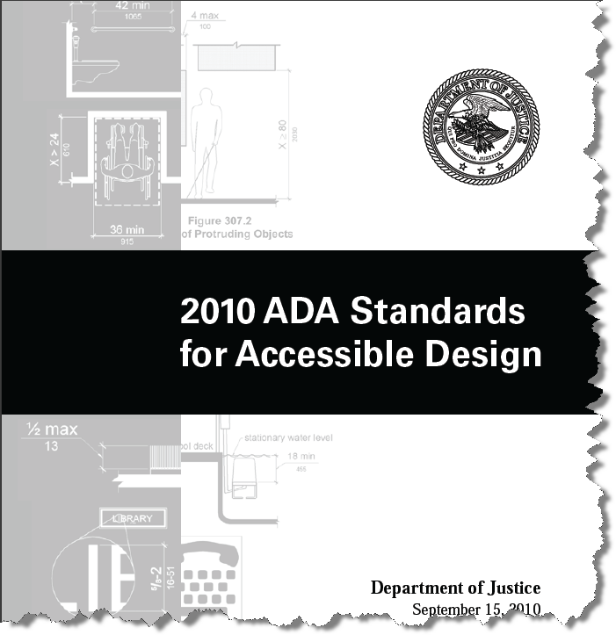
Governments are responding with guidelines, mandates, and legislation
Guidelines, mandates and legislation cover a broad area… including accessible travel.
UNITED STATES:
Americans with Disabilities Act (1991)
2010 ADA Standards for Accessible Design
AUSTRALIA: The Disability Discrimination Act (DDA) 1993
CANADA: National Persons with Disabilities Act
INDIA: The Persons with Disabilities (Equal Opportunities, Protection of Rights and Full Participation) Act, 1995.
UNITED KINGDOM: The Equity Act, 2010
UNITED NATIONS: Standard Rules on the Equalization of Opportunities for Disabled Persons, 1993 (policy guidelines)
OpenTravel Hotel Disability Project Component
@OpenTravel Alliance 2011, 2012
www.opentravel.org

Slide 6

A comprehensive audit of OpenTravel terminology, schema & code lists (with a focus on awareness)…
Spurred by recent amendments to the United States Department of Justice “2010 Americans with Disabilities Act (ADA)”, the goal of the OpenTravel Hotel Disability Project was to audit OpenTravel Hotel schema and schema supporting artifacts as follows:
To ensure that the applicable subsets of IT-related requirements from the 2010 ADA legislation were accommodated in the upcoming 2011B (December 2011) publication of OpenTravel Hotel schema;
To create and/or enhance 2011B reference (sample) schema instances;
To review existing OpenTravel Code List terminologies that reference products, services and/or features for disabled travelers to ensure that such terms use today’s socially acceptable terminology and update, add new and/or remove items as required; and,
To provide OpenTravel staff, governing bodies, members and implementers with a greater awareness of the accessibility market as it applies to ongoing schema design and enhancement.
@OpenTravel Alliance 2011, 2012
www.opentravel.org

Slide 7

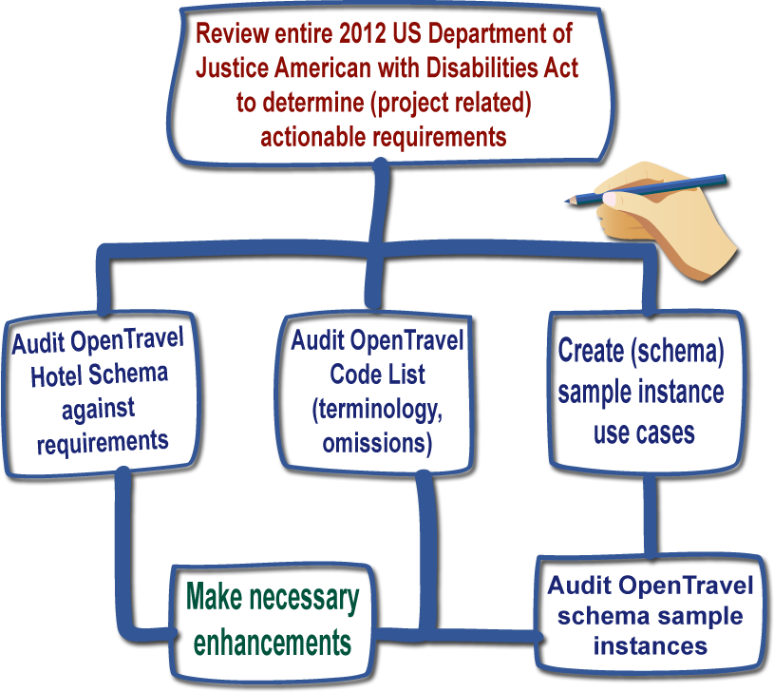





The team chose a methodical and repeatable approach…
Project approach highlights:
The team reviewed 20 (twenty) OpenTravel Hotel schema messages... and 4 (four) hotel-related Code List tables (that collectively represented hundreds of code items)
The team changed the name of the (existing) Physically Challenged Feature Code list table to “Disability Feature Code”. (To limit impact on implementers, they chose to not change the existing code list table acronym of “PHY”.)
To assist schema implementers, the team created a set of use cases used for schema sample instances (that contain sample data that describe possible scenarios for trading partners exchanging accessibility information)
The team made an enhancement to an OpenTravel Hotel common file to make it easier for implementers to describe accessibility dimensions
@OpenTravel Alliance 2011, 2012
www.opentravel.org
Notes:
From monolithic applications to modular reusable libraries

Slide 8
Four relevant legislative mandates were identified for audit…
After reviewing the 2010 US ADA legislation, the team subsequently identified 4 (four) relevant mandates that were within project scope:
1. Describe Accessible Features - Section 36.302(e)(1)(ii) - Identify and describe accessible features in the hotels and guest rooms offered through its reservations service in enough detail to reasonably permit individuals with disabilities to assess independently whether a given hotel or guest room meets his or her accessibility needs.
2. Hold Accessible Rooms Until Last - Section 36.302(e)(1)(iii) - Ensure that accessible guest rooms are held for use by individuals with disabilities until all other guest rooms of that type have been rented and the accessible room is the only remaining room of that type.
3. Block Rooms to Ensure Availability - Section 36.302(e)(1)(iv) - Reserve, upon request, accessible guest rooms or specific types of guest rooms and ensure that the guest rooms requested are blocked and removed from all reservations systems.
4. Guarantee the Room is Held - Section 36.302(e)(1)(v) - Guarantee that the specific accessible guest room reserved through its reservations service is held for the reserving customer, regardless of whether a specific room is held in response to reservations made by others.
@OpenTravel Alliance 2011, 2012
www.opentravel.org

Slide 9
About OpenTravel
@OpenTravel Alliance 2011, 2012
www.opentravel.org

Slide 10


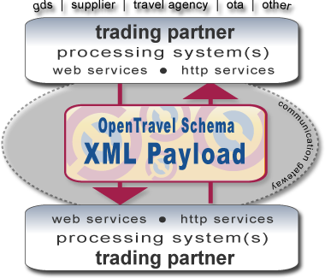
OpenTravel provides the defacto open source standard for the travel and leisure industry…
Introduction to OpenTravel (1/3)
The OpenTravel specification is used worldwide by travel industry suppliers, resellers, global distributors and integrators to meet customer and trading partner XML distribution demands.
Our products are built by and for travel companies…
Key Facts…
How would I use OpenTravel products?
Company
Membership funded, not for profit organization
Founded in 1999
Valyn Perini, CEO
Bonnie Lowell, Specification Manager
Specification
Open source
Free for all implementers
OpenTravel 1.0 XML Message Suite
OpenTravel 2.0 XML Object Suite
Numerous supporting artifacts for implementers
The OpenTravel specification is an XML transport layer that enables XML distribution within modern messaging frameworks.
Implementers bind OpenTravel schema with their web services to exchange information with their business transactions.
@OpenTravel Alliance 2011, 2012
www.opentravel.org

Slide 11

We serve multiple travel industry segments…
Introduction to OpenTravel (2/3)
The OpenTravel specification contains XML business functionality for numerous travel segments.
Our specification is used by suppliers, global distribution systems, online travel agents and integrators (to name a few.)
Booking path, descriptive information, notification and much more functionality is supported in the specification.
@OpenTravel Alliance 2011, 2012
www.opentravel.org
Notes:
As this slide aptly states, OpenTravel provides a lot more than XML specifications.
Starting in the middle of the diagram, you can see that OpenTravel provides two XML product suites, OpenTravel 1.0 Message Suite and OpenTravel 2.0 XML Object Suite. Both of these product suites use the OpenTravel Lexis (our common information exchange model) as a foundation and we’ll be discussing the Lexis in more detail shortly.
At the bottom of the slide, you’ll see that we provide a rich set of learning and reference artifacts for our implementers that describe our XML products and our common information exchange model. Our latest artifact suite, “OpenTravel Cookbooks”, that provide strategies for leveraging the OpenTravel specification to fulfill business requirements that go far beyond the basics. They explore how to make the most of the specification’s rich set of attributes and elements, including extending and enhancing the specification to meet unique requirements that your company may have..
A moderated forum is available for all implementers, with priority support for OpenTravel members
OpenTravel members have collaborated on creating a suite of schema management tools and applications that we’ll be discussing a bit later.
Web-based, project team spaces are available for all members and contain source versioned draft schema and other supporting design artifacts related to the project.
As you can see in this diagram, the OpenTravel Developers Network is our centralized member and implementer site that will be replacing our existing forum, wiki and project team space. It uses a single sign on method that authenticates and sets an access level—where members and implementers can download specifications and access the automated OpenTravel code list, learning resources, schema reference resources, the OpenTravel calendar and workgroup and project team portals.

Slide 12

Thank you and contact information…
Valyn Perini
CEO
valyn.perini@opentravel.org
www.opentravel.org
Skype: @opentravel
@OpenTravel Alliance 2011, 2012
www.opentravel.org

